Slide 1
Production Systems Control
Project
a.y. 2023 – 2024
Alberto Cantele
Prof. Luca Ferrarini

Slide 2


Shared resource with allocation request (1)
Two Users
TEACHER
STUDENT 1
STUDENT 2
Consider two students in a class-room “using” the single teacher, in the sense that each asks a question and is answered. When a student wants to pose a question, he calls the teacher’s attention by raising his hand and waits to be allowed to speak. Once the teacher gives his permission, the conversation continues until the student is satisfied.

Slide 3
Shared resource with allocation request (2)
Model of the student:
The states in which the students can be are three:
I: idle, student is just listening/waiting for an action.
R: requesting resources, student has raised up a hand and waits for teacher’s attention to ask the question.
U: using resources, teacher has given attention to the student and student asks the question.
The alphabet that moves the students from one state to another (events):
REQn: student n asks for the attention of the teacher (uncontrollable).
ASKn: student n uses the resource, asks the question to the teacher.
FREEn: student n has no more questions and releases the teacher (uncontrollable).

Slide 4
Shared resource with allocation request (3)
St:
R
REQn
ASKn
I
U
FREEn
St1:
St2:
R
R
REQ1
ASK1
REQ2
ASK2
I
U
I
U
FREE1
FREE2

Slide 5
Shared resource with allocation request (4)
Model of the teacher:
The states in which the teacher can be are three:
I: idle, the student is just listening/waiting for an action.
B1: busy state, student 1 has raised up a hand and the teacher has given to him the attention
B2: busy state, student 2 has raised up a hand and the teacher has given to him the attention
The alphabet that moves the teacher from one state to another (events):
REQn: student n asks for the attention of the teacher (uncontrollable).
FREEn: student n has no more questions and releases the teacher (uncontrollable).

Slide 6
Shared resource with allocation request (5)
T:
REQ2
REQ1
B2
I
B1
FREE2
FREE1
SPECIFICATIONS:
Sp1: the two users should not use the resource simultaneously and each user should always be able to repeat its request-use-release cycle;
Sp2: the user that first requests the resource should also be first granted access to it;
All specifications are already designed in the teacher model

Slide 7
Shared resource with allocation request (6)
From the point of view of the modular approach, the objective is to determine a way to compute the supervisor such that:
Data are simple to understand
The automata doesn’t present deadlocks or other issues
Specifications are optimally fulfilled
Starting from this, a good idea could be imposing the two specifications to the teacher (students are implemented in such a way that each student doesn’t know what the other does).
This could bring the final model to a nondeterministic automata, during the synchronous composition, as at a certain point both students can raise up their hands and teacher must choose which student comes first.

Slide 8
Shared resource with allocation request (7)
Modular approach means finding a way to create two or more sub supervisors. The synchronous composition of these supervisors brings to the Supremal non blocking supervisor. In the end non-blockingness and controllability must be verified
A good approach could be:
Sp=T= Teacher
P1=St1= Student 1
P2=St2= Student 2
The natural consequence is that:
S=S1||S2
S1<=S01=Sp||P1
S2<=S02=Sp||P2
So, using as notation: Q(Stn)_Q(T)

Slide 9
Shared resource with allocation request (8)
S01=Sp||P1=T||St1:
S02=Sp||P2=T||St2:
FREE1
FREE2
FREE2
FREE1
I_I
I_I
REQ1
REQ2
REQ2
REQ1
R_B1
I_B2
R_B2
I_B1
ASK1
ASK2
U_B1
U_B2
S1=S01 and S2=S02

Slide 10
Shared resource with allocation request (9)
S=S1||S2:
FREE1
FREE2
I_I_I
REQ1
REQ2
R_B1_I
I_B2_R
ASK1
ASK2
U_B1_I
I_B2_U
Using notation Q(St1)_Q(T)_Q(St2)

Slide 11
Shared resource with allocation request (10)
Observations:
No deadlocks occur
All two specifications are fulfilled as teacher can be used by one student per time and each student is able to call the teacher again as it finishes its process
A nondeterminism occurs at first state, both students can call simultaneously the teacher
Two ways can be used to solve this problem as shown in case of study 4
Accepting random behavior
A priority list
To complete the case of study, controllability and non-blockingness must be verified

Slide 12
Shared resource with allocation request (11)
Controllability:
Starting from the general formula for controllability:
L(S)𝛴𝜔 ∩ L(P) ⊆ L(S)
Substituting S and P:
L(S1||S2) 𝛴𝜔 ∩L(P1||P2) ⊆ L(S1||S2)
Applying the property L(a||b)=L(a) ∩ L(b):
[L(S1) ∩ L(S2)] 𝛴𝜔 ∩ L(P1) ∩ L(P2) ⊆ L(S1) ∩ L(S2)
Applying the associativity property:
L(S1) 𝛴𝜔 ∩ L(S2) 𝛴𝜔 ∩ L(P1) ∩ L(P2) ⊆ L(S1) ∩ L(S2)
As intersections, the solutions for S1 and S1 can be represented as a system:
L(S1) 𝛴𝜔 ∩L(P1) ⊆ L(S1)
L(S2) 𝛴𝜔 ∩L(P2) ⊆ L(S2)

Slide 13
Shared resource with allocation request (12)
Non-blockingness:
Before starting the demonstration, it is necessary to bring all the automata to the same alphabet in such a way that the procedure is more accurate and precise and mark the initial state as marked state.
S01=Sp||P1=T||St1:
S02=Sp||P2=T||St2:
FREE1
FREE2
FREE2
FREE1
I_I
I_I
REQ1
REQ2
REQ2
REQ1
ASK2
ASK1
R_B1
I_B2
R_B2
I_B1
ASK2
ASK1
ASK1
ASK2
ASK2
ASK1
U_B1
U_B2
ASK2
ASK1

Slide 14
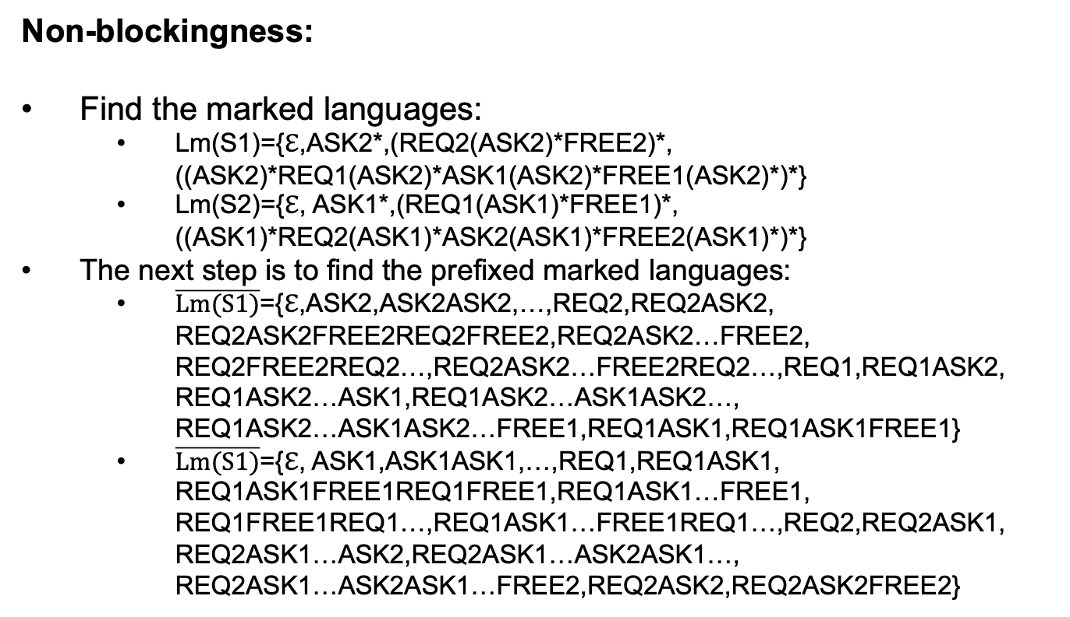
Shared resource with allocation request (13)
Non-blockingness:
Find the marked languages:
Lm(S1)={ℇ,ASK2*,(REQ2(ASK2)*FREE2)*, ((ASK2)*REQ1(ASK2)*ASK1(ASK2)*FREE1(ASK2)*)*}
Lm(S2)={ℇ, ASK1*,(REQ1(ASK1)*FREE1)*, ((ASK1)*REQ2(ASK1)*ASK2(ASK1)*FREE2(ASK1)*)*}
The next step is to find the prefixed marked languages:
$\overline{Lm(S1)}$={ℇ,ASK2,ASK2ASK2,…,REQ2,REQ2ASK2, REQ2ASK2FREE2REQ2FREE2,REQ2ASK2…FREE2, REQ2FREE2REQ2…,REQ2ASK2…FREE2REQ2…,REQ1,REQ1ASK2, REQ1ASK2…ASK1,REQ1ASK2…ASK1ASK2…, REQ1ASK2…ASK1ASK2…FREE1,REQ1ASK1,REQ1ASK1FREE1}
$\overline{Lm(S1)}$={ℇ, ASK1,ASK1ASK1,…,REQ1,REQ1ASK1, REQ1ASK1FREE1REQ1FREE1,REQ1ASK1…FREE1, REQ1FREE1REQ1…,REQ1ASK1…FREE1REQ1…,REQ2,REQ2ASK1, REQ2ASK1…ASK2,REQ2ASK1…ASK2ASK1…, REQ2ASK1…ASK2ASK1…FREE2,REQ2ASK2,REQ2ASK2FREE2}

Slide 15
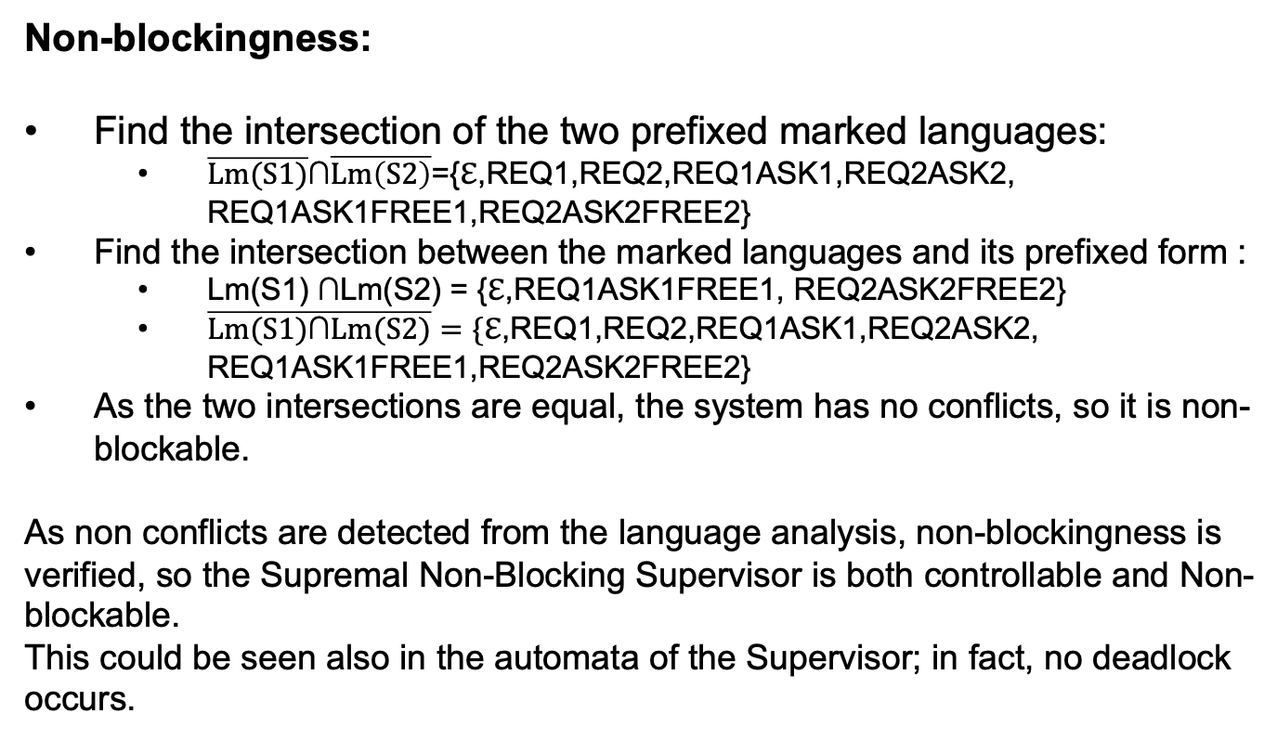
Shared resource with allocation request (14)
Non-blockingness:
Find the intersection of the two prefixed marked languages:
$\overline{Lm(S1)}$∩$\overline{Lm\left(S2\right)}$={ℇ,REQ1,REQ2,REQ1ASK1,REQ2ASK2, REQ1ASK1FREE1,REQ2ASK2FREE2}
Find the intersection between the marked languages and its prefixed form :
Lm(S1) $\text{∩}$Lm(S2) = {ℇ,REQ1ASK1FREE1, REQ2ASK2FREE2}
$\overline{Lm(S1)\text{∩}Lm(S2)}=\{$ℇ,REQ1,REQ2,REQ1ASK1,REQ2ASK2, REQ1ASK1FREE1,REQ2ASK2FREE2}
As the two intersections are equal, the system has no conflicts, so it is non-blockable.
As non conflicts are detected from the language analysis, non-blockingness is verified, so the Supremal Non-Blocking Supervisor is both controllable and Non-blockable.
This could be seen also in the automata of the Supervisor; in fact, no deadlock occurs.

